Slide 1
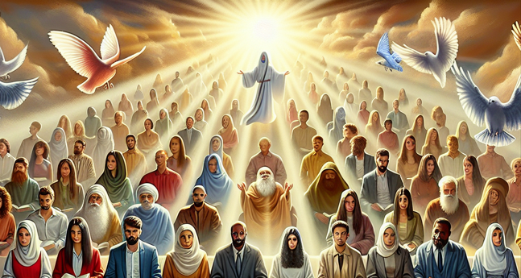

Awaiting Christ’s Return
I Thessalonians 5:1-10
Notes:
Will Gossett ~ March 29, 2026

Slide 2
I Thessalonians 5:1-10 (NASB)
¹ Now as to the times and the epochs, brethren, you have no need of anything to be written to you. ² For you yourselves know full well that the day of the Lord will come just like a thief in the night.

Slide 3
I Thessalonians 5:1-10 (NASB)
³ While they are saying, “Peace and safety!” then destruction will come upon them suddenly like labor pains upon a woman with child, and they will not escape. ⁴ But you, brethren, are not in darkness, that the day would overtake you like a thief;

Slide 4
I Thessalonians 5:1-10 (NASB)
⁵ for you are all sons of light and sons of day. We are not of night nor of darkness; ⁶ so then let us not sleep as others do, but let us be alert and sober. ⁷ For those who sleep do their sleeping at night, and those who get drunk get drunk at night.

Slide 5
I Thessalonians 5:1-10 (NASB)
⁸ But since we are of the day, let us be sober, having put on the breastplate of faith and love, and as a helmet, the hope of salvation.
⁹ For God has not destined us for wrath, but for obtaining salvation through our Lord Jesus Christ,

Slide 6
I Thessalonians 5:1-10 (NASB)
¹⁰ who died for us, so that whether we are awake or asleep, we will live together with Him.

Slide 7
The Greek word nepho (nay-fo) [sober]
Signifies “to be free from the influence of intoxicants”. This is the same word Peter used in 1 Peter 1, and 1 Peter 5.
In both of these contexts, Peter is using sober to signify staying alert.

Slide 8
Paul’s use of the word contextually is being alert as well. We must note, to be free from intoxicants is to be free from all deluding factors that can affect our sobriety within the Word.

Slide 9
Awaiting Christ’s Return
Day of the Lord
Of the Light
Destined for Salvation

Slide 10
Day of the Lord vs. 1-4
Matthew 24:36-43 (NASB 1995)
II Peter 3:8-11 (NASB 1995)

Slide 11
Matthew 24:36-43 (NASB)
³⁶ “But of that day and hour no one knows, not even the angels of heaven, nor the Son, but the Father alone. ³⁷ For the coming of the Son of Man will be just like the days of Noah.

Slide 12
Matthew 24:36-43 (NASB)
³⁸ For as in those days before the flood they were eating and drinking, marrying and giving in marriage, until the day that Noah entered the ark, ³⁹ and they did not understand until the flood came and took them all away;

Slide 13
Matthew 24:36-43 (NASB)
so will the coming of the Son of Man be. ⁴⁰ Then there will be two men in the field; one will be taken and one will be left. ⁴¹ Two women will be grinding at the mill; one will be taken and one will be left. ⁴² “Therefore be on the alert,

Slide 14
Matthew 24:36-43 (NASB)
for you do not know which day your Lord is coming. ⁴³ But be sure of this, that if the head of the house had known at what time of the night the thief was coming, he would have been on the alert and would not have allowed his house to be broken into.

Slide 15
II Peter 3:8-11 (NASB)
⁸ But do not let this one fact escape your notice, beloved, that with the Lord one day is like a thousand years, and a thousand years like one day.

Slide 16
II Peter 3:8-11 (NASB)
⁹ The Lord is not slow about His promise, as some count slowness, but is patient toward you, not wishing for any to perish but for all to come to repentance.

Slide 17
II Peter 3:8-11 (NASB)
¹⁰ But the day of the Lord will come like a thief, in which the heavens will pass away with a roar and the elements will be destroyed with intense heat, and the earth and its works will be burned up.

Slide 18
II Peter 3:8-11 (NASB)
¹¹ Since all these things are to be destroyed in this way, what sort of people ought you to be in holy conduct and godliness,

Slide 19
Of the Light vs. 5-8
I John 1:5-7 (NASB 1995)
Ephesians 5:6-10 (NASB 1995)
Isaiah 59:17 (NASB 1995)
Ephesians 6:14-17 (NASB 1995)

Slide 20
I John 1:5-7 (NASB)
⁵ This is the message we have heard from Him and announce to you, that God is Light, and in Him there is no darkness at all. ⁶ If we say that we have fellowship with Him and yet walk in the darkness, we lie and do not practice the truth;

Slide 21
I John 1:5-7 (NASB)
⁷ but if we walk in the Light as He Himself is in the Light, we have fellowship with one another, and the blood of Jesus His Son cleanses us from all sin.

Slide 22
Ephesians 5:6-10 (NASB)
⁶ Let no one deceive you with empty words, for because of these things the wrath of God comes upon the sons of disobedience.

Slide 23
Ephesians 5:6-10 (NASB)
⁷ Therefore do not be partakers with them; ⁸ for you were formerly darkness, but now you are Light in the Lord; walk as children of Light

Slide 24
Ephesians 5:6-10 (NASB)
⁹ (for the fruit of the Light consists in all goodness and righteousness and truth), ¹⁰ trying to learn what is pleasing to the Lord.

Slide 25
Isaiah 59:17 (NASB)
He put on righteousness like a breastplate, And a helmet of salvation on His head; And He put on garments of vengeance for clothing And wrapped Himself with zeal as a mantle.

Slide 26
Ephesians 6:14-17 (NASB)
¹⁴ Stand firm therefore, having girded your loins with truth, and having put on the breastplate of righteousness, ¹⁵ and having shod your feet with the preparation of the gospel of peace;

Slide 27
Ephesians 6:14-17 (NASB)
¹⁶ in addition to all, taking up the shield of faith with which you will be able to extinguish all the flaming arrows of the evil one. ¹⁷ And take the helmet of salvation, and the sword of the Spirit, which is the word of God.

Slide 28
Destined for Salvation vs. 9-10
I Corinthians 15:42-46 (NASB 1995)
James 1:12 (NASB 1995)
Revelation 2:10 (NASB 1995)
II Timothy 4:6-8 (NASB 1995)

Slide 29
I Corinthians 15:42-46 (NASB)
⁴² So also is the resurrection of the dead. It is sown a perishable body, it is raised an imperishable body; ⁴³ it is sown in dishonor, it is raised in glory;

Slide 30
I Corinthians 15:42-46 (NASB)
it is sown in weakness, it is raised in power; ⁴⁴ it is sown a natural body, it is raised a spiritual body. If there is a natural body, there is also a spiritual body.

Slide 31
I Corinthians 15:42-46 (NASB)
⁴⁵ So also it is written, “The first man, Adam, became a living soul.” The last Adam became a life-giving spirit. ⁴⁶ However, the spiritual is not first, but the natural; then the spiritual.

Slide 32
James 1:12 (NASB)
Blessed is a man who perseveres under trial; for once he has been approved, he will receive the crown of life which the Lord has promised to those who love Him.

Slide 33
Revelation 2:10 (NASB)
Do not fear what you are about to suffer. Behold, the devil is about to cast some of you into prison, so that you will be tested, and you will have tribulation for ten days. Be faithful until death, and I will give you the crown of life.

Slide 34
II Timothy 4:6-8 (NASB)
⁶ For I am already being poured out as a drink offering, and the time of my departure has come.
⁷ I have fought the good fight, I have finished the course, I have kept the faith;

Slide 35
II Timothy 4:6-8 (NASB)
⁸ in the future there is laid up for me the crown of righteousness, which the Lord, the righteous Judge, will award to me on that day; and not only to me, but also to all who have loved His appearing

Slide 36
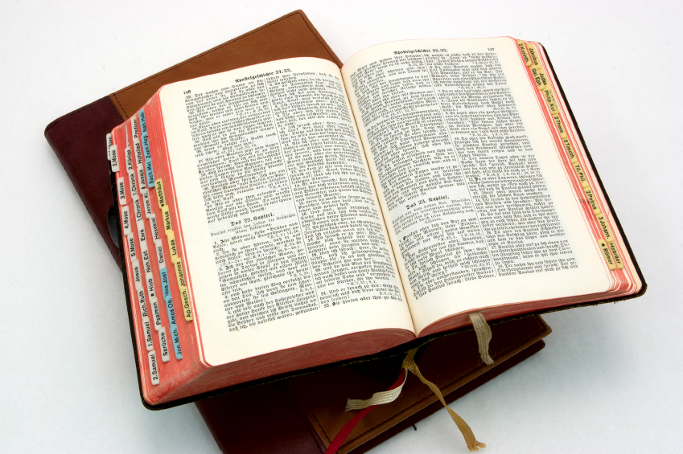
Hear: Romans 10:17
So then faith cometh by hearing, and hearing by the word of God.

Slide 37
Believe: Hebrews 11:6
But without faith it is impossible to please him: for he that cometh to God must believe that he is, and that he is a rewarder of them that diligently seek him.

Slide 38
Repent: Luke 13:3
I tell you, Nay: but, except ye repent, ye shall all likewise perish.

Slide 39
Confess: Matthew 10:32-33
32 Whosoever therefore shall confess me before men, him will I confess also before my Father which is in heaven.
33 But whosoever shall deny me before men, him will I also deny before my Father which is in heaven.

Slide 40
Baptize: Acts 22:16
And now why tarriest thou? arise, and be baptized, and wash away thy sins, calling on the name of the Lord.

